Slide 1

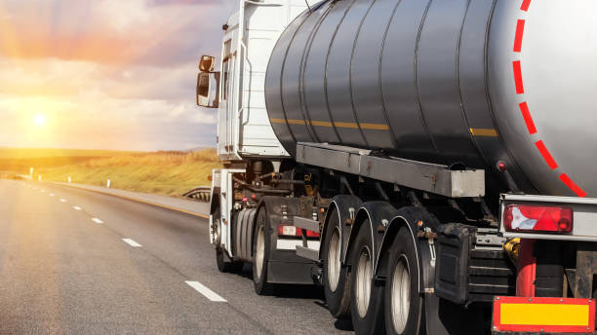
Fuel delivery Certificate
By
Pradeep Mandapati

Slide 2
Agenda
Fuel Delivery Certificate
Veeder-Root Reading
Problem Statement
MNIST Data Set
Data Visualization
Navie Bayes Classifier
Gaussian classifier
K Nearest Neighbours.
Conclusion
Questions

Slide 3
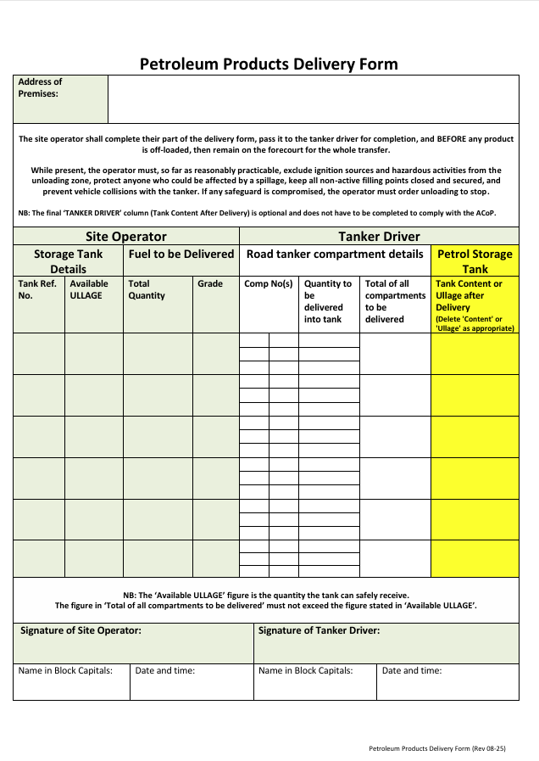
Fuel Delivery Certificate
It is mandatory to fill a fuel delivery certificate as per the law in UK.
It contains all the information about:
  Supplier and customer details
  Product Identification
  Quantity Delivered
  Date and time of Delivery
  Safety & Regulatory Compliance Information

Slide 4
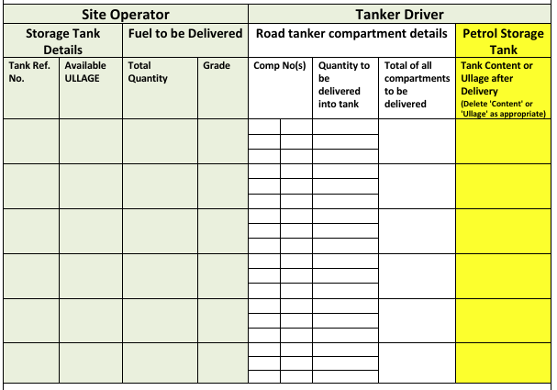
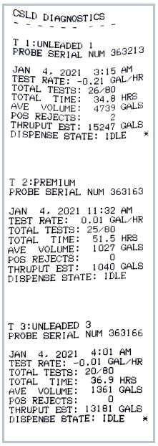
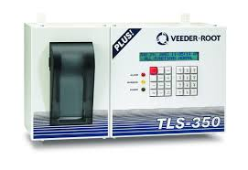
Quantity Delivered
Information related to the quantity of the fuel must be filled manually in the certificate.
We get this information from Veeder Root available at the station.

Slide 5
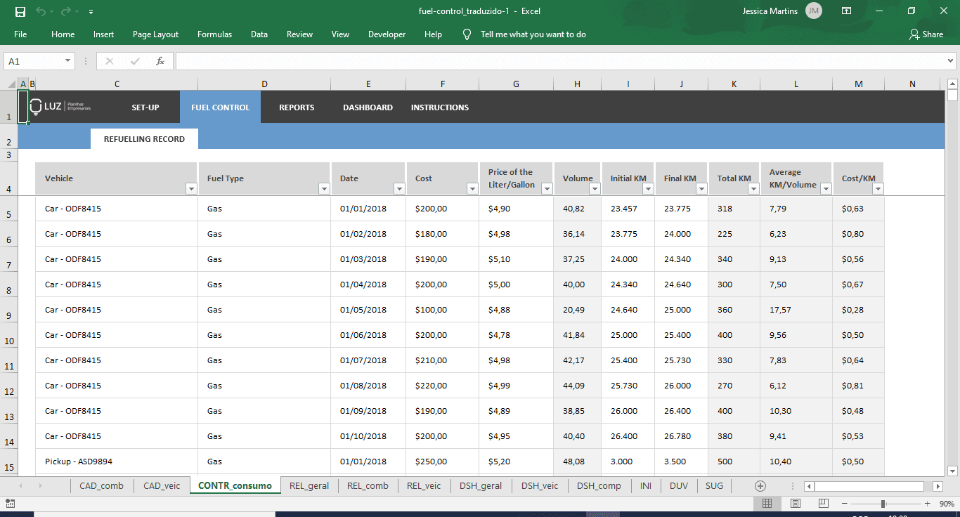
Problem Statement
The information from the Veeder Root should be digitalized
By automation, It will reduce the chance of error when entering the data into data base.

Slide 6
MNIST Data Set
MNIST(Modified National institute of Standards and Technology) is a large data contains 70,000(60,000 training images and 10,000 testing images) grayscale images of digits 0 to 9.
Set taken from American census bureau employees(Training data set) and American High School(Test data set) normalized into a 28X28 pixel which introduced grayscale level.
Source: https://en.wikipedia.org/wiki/MNIST_database

Slide 7
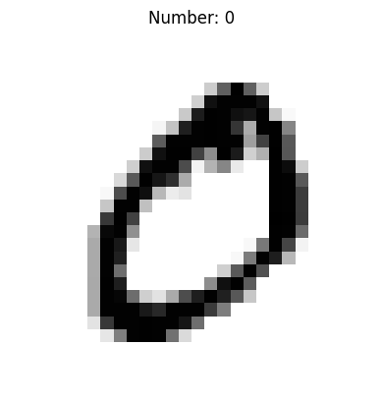
Data Visualization
Each row has a value and its corresponding 28*28-pixel information as a row vector.
The second row when visualized according to pixel
intensity, appears as shown in the image

Slide 8
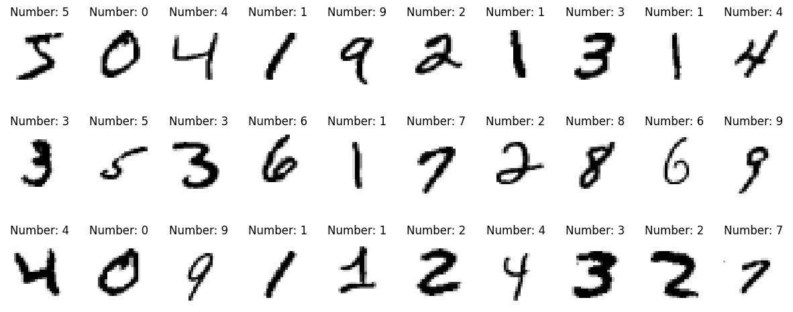
Cont.
The visualization of first 30 rows appears as shown in the image

Slide 9
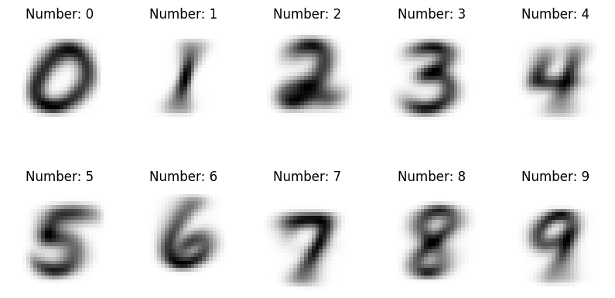
Cont.
The visualization of average of the information appears as below:

Slide 10
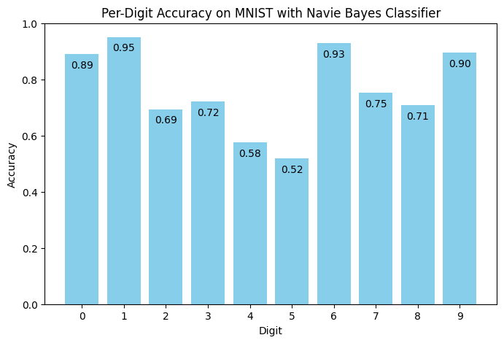
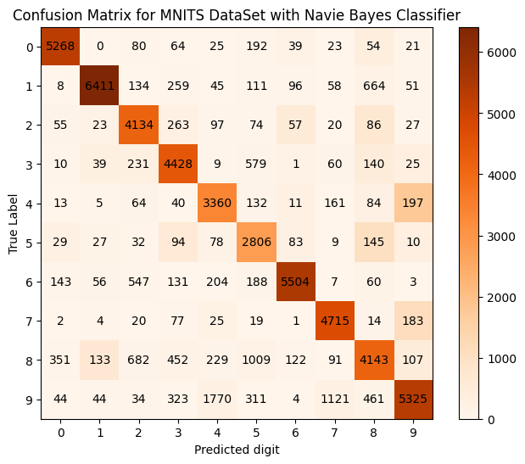
Navie Bayes Classifier
The Confusion Matrix and the accuracy appears as below
Observations:

Slide 11
Observations.
The accuracy of the model is 76.82%
The digit 0 is identified correctly with an accuracy of 0.89. In very few cases it was read as 8 or 6
The digit 1 is identified correctly with an accuracy of 0.95. In very few cases it was read as 8
The digit 2 is identified correctly with an accuracy of 0.62. In very few cases it was read as 8 or 6 or 3
The digit 3 is identified correctly with an accuracy of 0.72. In very few cases it was read as 8 or 9 or 2 or 1
The digit 4 is identified correctly with an accuracy of 0.58. In very few cases it was read as 9
The digit 5 is identified correctly with an accuracy of 0.52. In very few cases it was read as 8 or 3 or 9
The digit 6 is identified correctly with an accuracy of 0.93. In very few cases it was read as 8
The digit 7 is identified correctly with an accuracy of 0.75. In very few cases it was read as 9 or 4
The digit 8 is identified correctly with an accuracy of 0.71. In very few cases it was read as 9 or 1
The digit 9 is identified correctly with an accuracy of 0.90. In very few cases it was read as 7 or 4

Slide 12
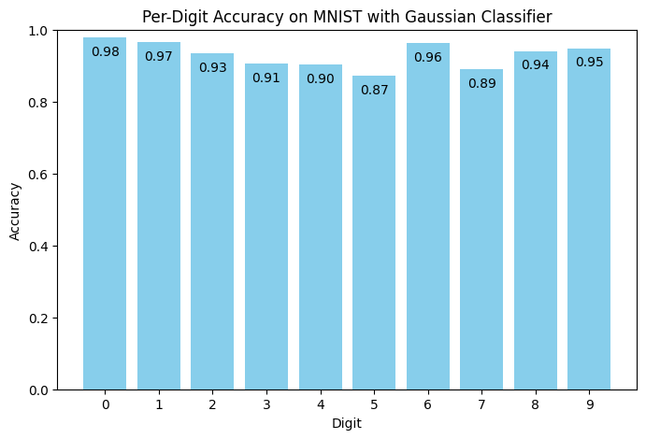
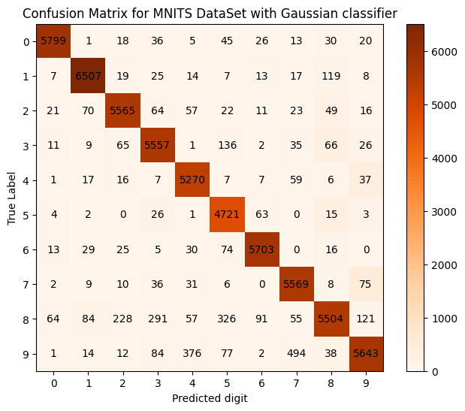
Gaussian classifier
The accuracy of the model is 93.06%
The Confusion Matrix and the accuracy appears as below

Slide 13
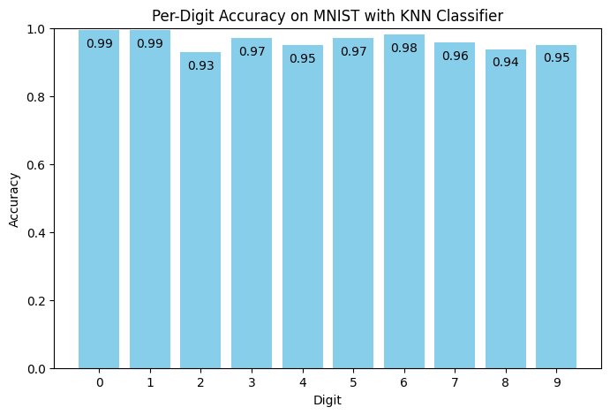
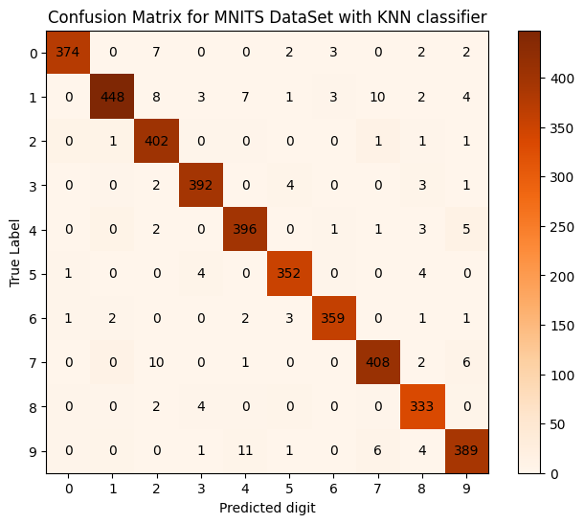
K Nearest Neighbours.
The accuracy of the model is 96.32%(K=21)
The Confusion Matrix and the accuracy appears as below

Slide 14
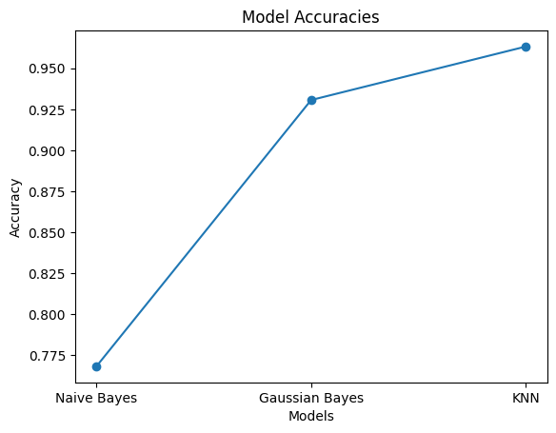
Conclusion
The digitalization of fuel certificate can be achieved using MNIST data set.
The accuracy of the digitalization depends on the model we choose, and the accuracy of various model is shown below.

Slide 15
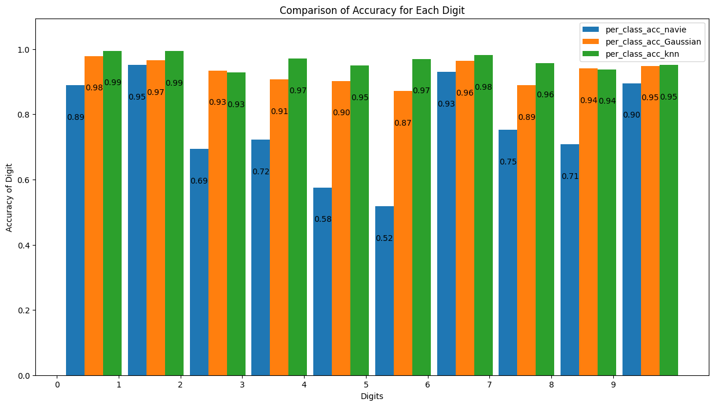
Cont.
The Accuracy of identifying each digit with every model is as below

Slide 16
Questions
?

Slide 17
Thank You.

Slide 18

Useful Information
The Volume of fuel is function of pressure and Temperature.
$$volume(v)∝\frac{Temperature(T)}{Pressure(P)}$$
There are 10 classifications here. To avoid ambiguity during KNN, K should not be a multiple of 10. Higher value of K can overfit the model and very low value of K can underfit the model.

